Slide 1
“Video Signal Compression”
Mikołaj Leszczuk
22.02.2025

Slide 2
Why Video Signal Compression?
Uncompressed video (PAL) stream ∼250 Mbit/s
Compression required!
Compressed video (PAL) stream ∼2 Mbit/s
Achieved video compression ratio: ∼1:100
www.agh.edu.pl

Slide 3

www.agh.edu.pl

Slide 4
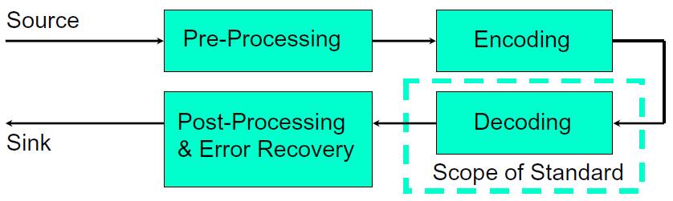
Scope of Standardization of Video Coding
Standardised areas: bit-stream (format, bitrate, etc.), syntax, decoder
Possibility of unlimited encoder optimization and code complexity reduction
No guarantee of quality
Source: Thomas Wiegand, New Techniques for Improved Video Coding

Slide 5

Enter the names of the codecs you know used for the video...
https://www.menti.com/my7qt6vpok

Slide 6
Notable Examples of Motion Image Codecs
Intra-Frame Compression
Inter-Frame Compression
M-JPEG (Motion – JPEG)
M-JPEG2000
Apple Pro-Res (Professional Resolution)
DV (Digital Video)
MPEG-1 (Motion Picture Experts Group – 1)
MPEG-2
H.263
MPEG-4
H.264/AVC (Advanced Video Coding)
H.265/HEVC (High Efficiency Video Coding)
Notes:
Storage of content in digital video libraries - generation of video codecs.
Intra-frame compression generation: zero generation.
Inter-frame compression generation: 1st, 2nd, 3rd and 4th generation and non-standardized codecs.

Slide 7
Evolution of Selected Codecs
MPEG-1
MPEG-4
H.264/AVC
H.265/HEVC
MPEG-2
H.263

Slide 8
MPEG-1 – General Info
Acceptable video quality at 1.5 Mbit/s
Comparable to VHS
Resolutions:
352×288 (25,00 FPS)
352×240 (29,97 FPS)
FPS – Frames Per Second
„Mpeg” by Moving Picture Experts Group – http://mpeg.chiariglione.org/. Licensed under CC BY-SA 3.0 via Commons – https://commons.wikimedia.org/wiki/File:Mpeg.gif#/media/File:Mpeg.gif
Notes:
MPEG-1 is a standard for lossy compression of video and audio. It is designed to compress VHS-quality raw digital video down to about 1.5 Mbit/s without excessive quality loss, making video CDs, digital cable/satellite TV possible. Initial release: 1993.
Then, MPEG-1 has become the most widely compatible lossy audio/video format in the world and was used in many products and technologies.

Slide 9
Basic Assumptions of MPEG-1 Compression
JPEG-like compression in spatial domain (intra-frame)
Compression in temporal domain (inter-frame)
Difference between frames
Estimation of motion vector
Motion vector prediction
Lossless compression (entropy coding)
Huffman Coding
Arithmetic Coding

Slide 10
Compression in Temporal Domain (Inter-Frame)
Only updating changing blocks to decrease redundancy
Known as conditional replenishment
However, not very effective by itself
Need to update large portions of frame if:
Objects movement
Camera movement
Encoder compensating motion through motion estimation

Slide 11

Motion Vectors
Notes:
In video compression, a motion vector is the key element in the motion estimation process. It is used to represent a macroblock in a picture based on the position of this macroblock (or a similar one) in another picture, called the reference picture.
A two-dimensional vector used for inter prediction that provides an offset from the coordinates in the decoded picture to the coordinates in a reference picture.

Slide 12
MPEG-2
Like previous MPEG-1 standard
Support for interlaced video format used by analogue broadcast TV systems
Not optimized for low bit-rates, especially ＜1 Mbit/s at standard definition TV
Outperforming MPEG-1 at ≧3 Mbit/s
With some enhancements also used in some high-definition TV systems
Notes:
MPEG-2 is a standard for "the generic coding of moving pictures and associated audio information". It describes a combination of lossy video compression and lossy audio data compression methods, which permit storage and transmission of movies using currently available storage media and transmission bandwidth. While MPEG-2 is not as efficient as newer standards it is still widely used, for example in over-the-air digital television broadcasting and in the DVD-Video standard.

Slide 13
H.263
Designed as low-bit-rate compressed format for videoconferencing
Also found many applications on Internet:
Flash Video (YouTube, Google Video, MySpace, etc.)
RealVideo
Developed as evolutionary improvement based on experience from MPEG-1/MPEG-2
Further enhanced into MPEG-4
Notes:
H.263 is a video compression standard originally designed as a low-bit-rate compressed format for videoconferencing. It was standardized by the ITU-T Video Coding Experts Group (VCEG) in a project ending in 1995/1996. It is a member of the H.26x family of video coding standards in the domain of the ITU-T.
Like previous H.26x standards, H.263 is based on discrete cosine transform (DCT) video compression.[1] H.263 was later extended to add various additional enhanced features in 1998 and 2000. Smaller additions were also made in 1997 and 2001, and a unified edition was produced in 2005.

Slide 14
MPEG-4 – General Info
MPEG-4 = audio + video + other media + interactivity + scalability
Passive access (prior MPEG-4): start, stop, pause
Interactive access (MPEG-4): manipulate elements, reposition, delete, alter motion
Scalability allowing streaming over low bit-rate (mobile networks)
Notes:
MPEG-4 is a method of defining compression of audio and visual (AV) digital data. It was introduced in late 1998 and designated a standard for a group of audio and video coding formats and related technology agreed upon by the ISO/IEC Moving Picture Experts Group (MPEG) under the formal standard ISO/IEC 14496 – Coding of audio-visual objects. Uses of MPEG-4 include compression of AV data for web (streaming media) and CD distribution, voice (telephone, videophone) and broadcast television applications.

Slide 15
MPEG-4 Media-Objects
Scene
Moving Image
Audio
Graphics
Film
Facial Animation (Avatar)
3D Grid
Music
Speech
Synthetic Sound
2D
3D
Each frame segmented by:
Shape
Motion
Texture
Video Object Planes (VOPs)
Each VOP encoded separately
Notes:
MPEG-4 is an object-based multimedia compression standard which allows to encode different audio-visual objects (AVOs). The MPEG-4 group has proposed an architecture for the efficient representation and coding of synthetically and naturally generated audio-visual information.

Slide 16
MPEG-4 Content-Based Video Coding Principles
Notes:
The approach taken by the experts' group in coding of video for multimedia applications relies on a content-based visual data representation of scenes. In content-based coding, in contrast to conventional video coding techniques, a scene is viewed as a composition of video objects (VO) with intrinsic properties such as shape, motion and texture. It is believed that such a content-based representation is a key to facilitating interactivity with objects for a variety of multimedia applications. In such applications, the user can access arbitrarily shaped objects in the scene and manipulate these objects.

Slide 17
H.264/AVC Hybrid Video Coder
New techniques for improved video coding
Source: Thomas Wiegand
Notes:
H.264, also referred to as Advanced Video Coding (AVC), is a video compression standard based on block-oriented, motion-compensated integer-DCT coding. It is by far one of the most commonly used formats for the recording, compression, and distribution of video content, used by ~90% of video industry developers. It supports resolutions up to and including 8K UHD.

Slide 18
H.265/HEVC
Newest video compression standard
Launched in 2013
Successor to H.264/AVC
Features:
Improved video quality
“Double” compression ratio compared to H.264/AVC
Support for resolutions up to 8K UHD (7680×4320)
Notes:
H.265, also known as High Efficiency Video Coding (HEVC), is a video compression standard designed as a successor to the widely used Advanced Video Coding (AVC, H.264). In comparison to AVC, HEVC offers from 25% to 50% better data compression at the same level of video quality, or substantially improved video quality at the same bit rate. It supports resolutions up to 8192×4320, including 8K UHD, and unlike the primarily 8-bit AVC, HEVC's higher fidelity Main10 profile has been incorporated into nearly all supporting hardware.

Slide 19
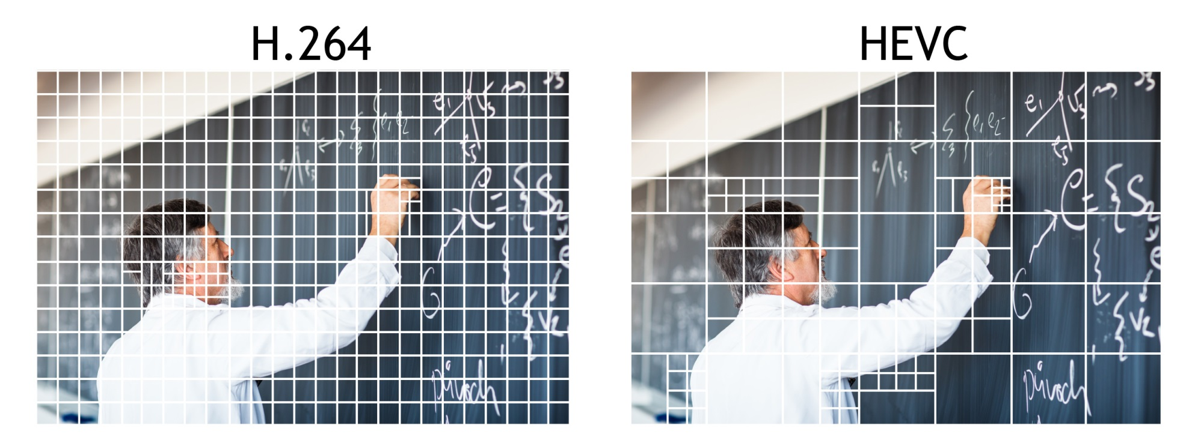
Codecs Are Homogenous
HEVC- What's Next in Video Compression, © Z3 Technology, http://z3technology.com/

Slide 20
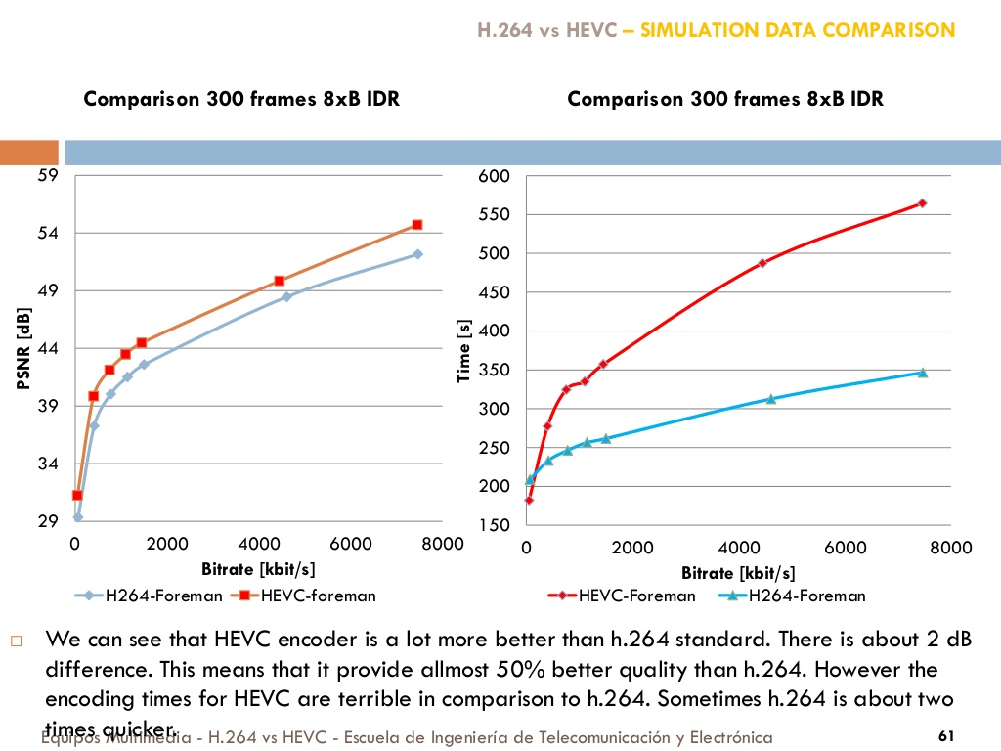
Comparison between H.264/AVC and H.265/HEVC

Slide 21
Comparison of Video Coding Standards
Video coding standard | Average bit rate reduction
 | H.264/ AVC | MPEG-4 | H.263 | MPEG-2
H.265/ HEVC | 35% | 64% | 65% | 71%
H.264/ AVC | - | 45% | 47% | 55%
MPEG-4 | - | - | 4% | 20%
H.263 | - | - | - | 16%
Based on:
Equal quality
Common source reference circuits (SRC, video sequences)

Slide 22
Versatile Video Coding (VVC)
Also known as:
H.266
ISO/IEC 23090-3
MPEG-I Part 3
Future Video Coding (FVC)
Video compression standard finalized on 6 July 2020, by the Joint Video Experts Team (JVET)
Successor to H.266/HEVC
Aim: to make 4K broadcast and streaming commercially viable
Notes:
Versatile Video Coding (VVC), also known as H.266, ISO/IEC 23090-3,[1] MPEG-I Part 3 and Future Video Coding (FVC), is a video compression standard finalized on 6 July 2020, by the Joint Video Experts Team (JVET), a united video expert team of the MPEG working group of ISO/IEC JTC 1 and the VCEG working group of ITU-T. It is the successor to High Efficiency Video Coding (HEVC, also known as ITU-T H.265 and MPEG-H Part 2). The aim is to make 4K broadcast and streaming commercially viable.

Slide 23
Enter the names of the codecs you know used for the video...
https://www.mentimeter.com/s/722bf6c9435ae1a582080063f922a436/9efa36bda4c4

Slide 24
Addition Reference
Damian Karwowski, „Zrozumieć Kompresję Obrazu”, Poznań 2019, https://www.zrozumieckompresje.pl/ (in Polish)

Slide 25
Common SRCs
Why to use?
Where to find?
To progress areas of:
Consumer video processing
Visual quality assessment
To set high quality royalty-free materials
To keep uniform scoring procedures
Consumer Digital Video Library (CDVL)
Laboratory for Image and Video Engineering (LIVE)
Text Retrieval Conference – Video Retrieval Evaluation (TRECVID)
AGH resources

Slide 26

CDVL
Digital video library intended for researchers and developers
Providing relevant video clips for different types of modalities
Filling critical industry needs
Sharing contributions of video content being most relevant for:
Determining effectiveness of consumer video processing
Quality measurement algorithms
http://www.cdvl.org/

Slide 27

LIVE
Databases for quality evaluation:
General video
HTTP-based video streaming
Mobile video
http://live.ece.utexas.edu/

Slide 28

TRECVID
Large test collection
Uniform scoring procedures
Forum for comparing results
http://trecvid.nist.gov/

Slide 29
AGH Resources
Downloadable videos
Available to research community free of charge
Ground truth quality scores downloadable as well
Two scientific video libraries:
Small-scale surveillance video
Large-scale general video
http://vq.kt.agh.edu.pl

